Slide 1



Active Long Fixation Correlates with the Formation
of Long-Term Memory
Lab Seminar
October 10, 2014
Jin Hwa Kim
Biointelligence Lab.
Program in Cognitive Science
Seoul National University

Slide 2

Attention

Slide 3
Attention

Slide 4
Attention
enables us to
focus

Slide 5
Attention
enables us to
focus
be efficient

Slide 6
Attention
enables us to
focus
be efficient
and think more.

Slide 7
The principal investigator adumbrated a research plan, but none of the researchers knew precisely what to do.

Slide 8
The principal investigator adumbrated a research plan, but none of the researchers knew precisely what to do.

Slide 9
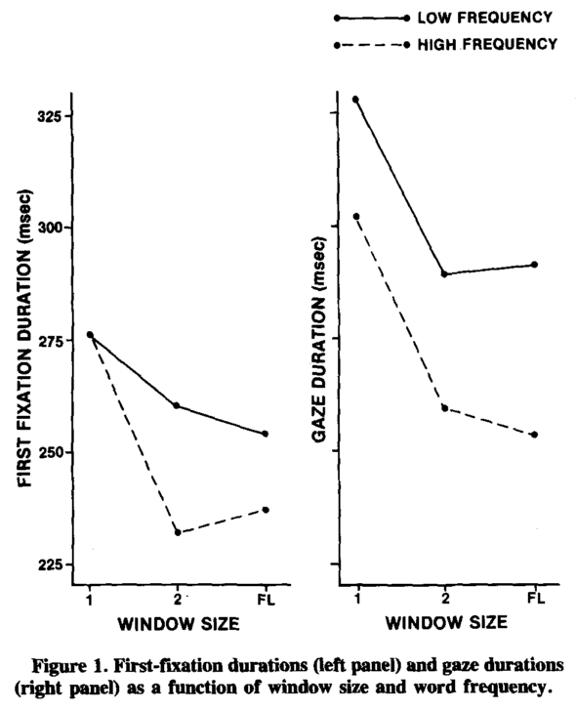
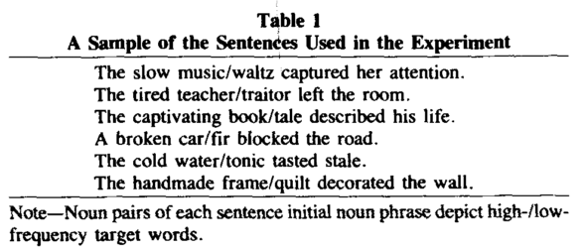
Fixation Duration on Word Frequency
Inhoff & Rayner, 1986

Slide 10
Mental Space of Emotion
Russell, 1980

Slide 11
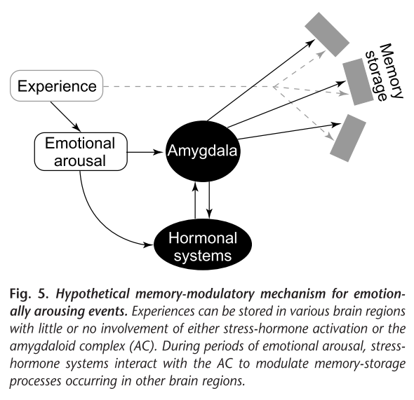
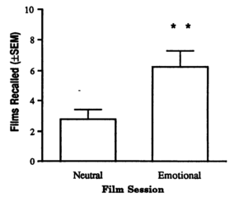
Arousal and LTM
Cahill et al., 1996; Cahill & McGaugh, 1998

Slide 12
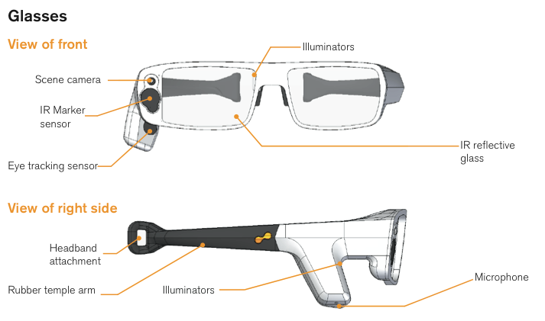
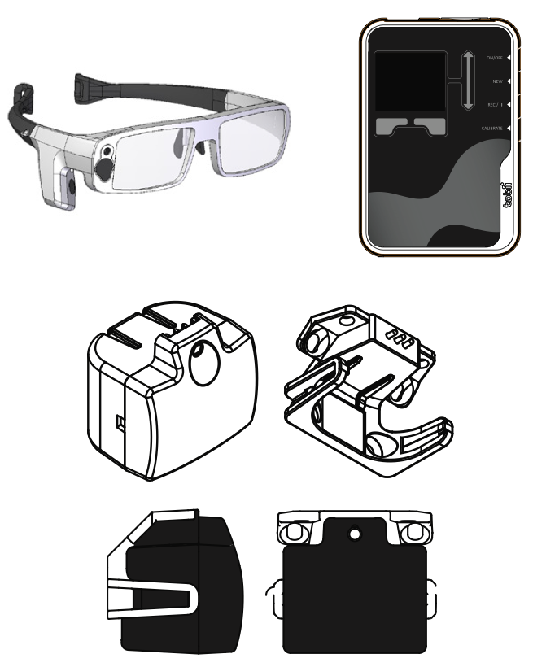
Tobii Glasses
http://www.tobii.com/en/eye-tracking-research/global/library/manuals/

Slide 13
Precedent Studies
The fixation duration is related to the presence of the cognitive process, for an instance, observing its correlation with linguistic attributes. (Inhoff & Rayner, 1986; Rayner & Duffy, 1986)
The sequences which potentially induce the emotional arousal are known for helping to recall the seen movie clips. (Cahill et al., 1996; Cahill & McGaugh, 1998)
The eye movement is a non-invasive and convenient indicator of the brain activities, the application of eyewear accelerates the study on the eye movement, especially beyond the reading task.

Slide 14
Research Hypothesis
What the visual constraints induce the long term of the fixation duration?
Do the long fixations correlate with the formation of long-term memory?
Does the fixation duration indicate the effectiveness of the long-term memory formation for the emotionally arousing sequences?

Slide 15
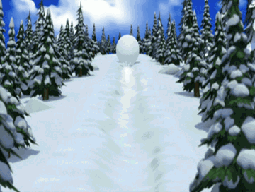




Long Fixation Types
Alerted
Successive
Stationary
HI
LOW
Emotional Arousal

Slide 16
Recall Test
Subject
11 participants who previously watched the video (> 3 months ago)
Material
Long fixated 8 sequences (> 1500 ms)
Short fixated 8 sequences (< 300 ms)
Not seen 4 sequences (other season episodes)

Slide 17
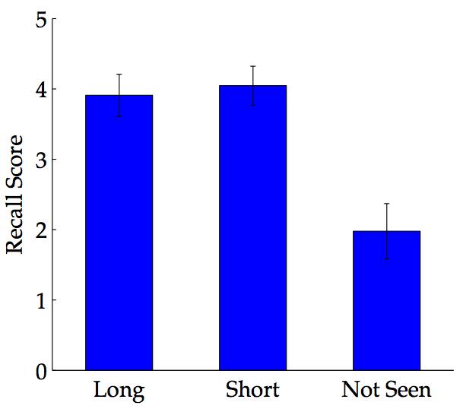
Results of Recall Test

Slide 18
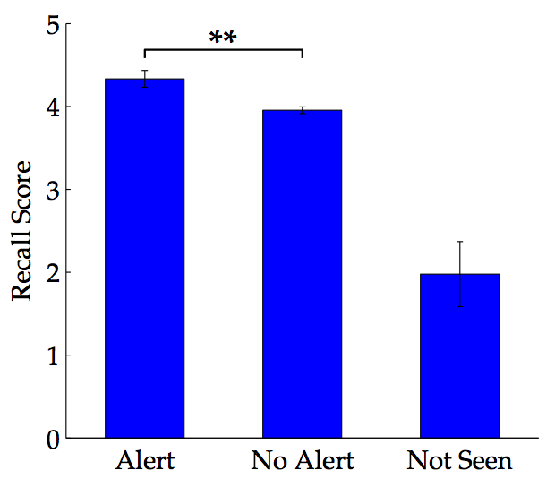
Results of Recall Test

Slide 19
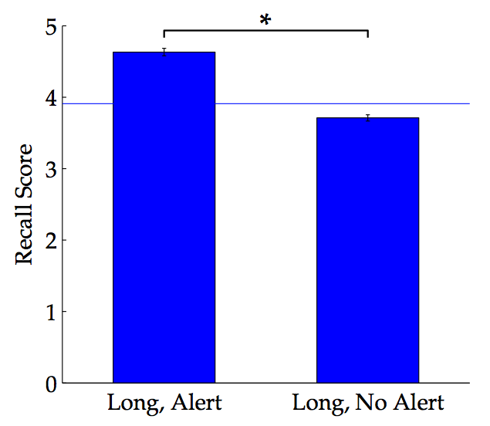
Results of Recall Test

Slide 20
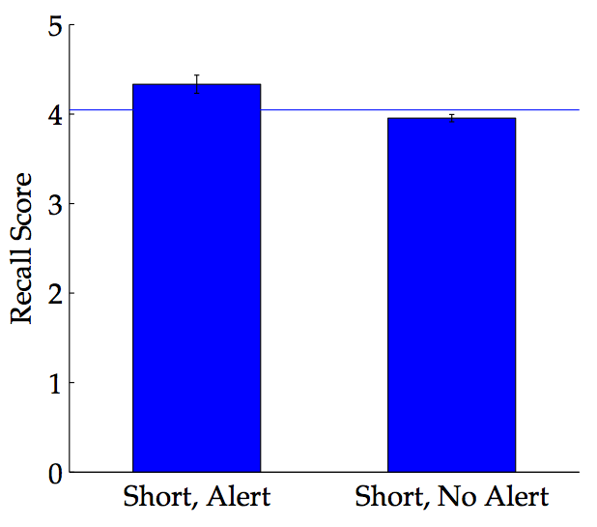
Results of Recall Test

Slide 21
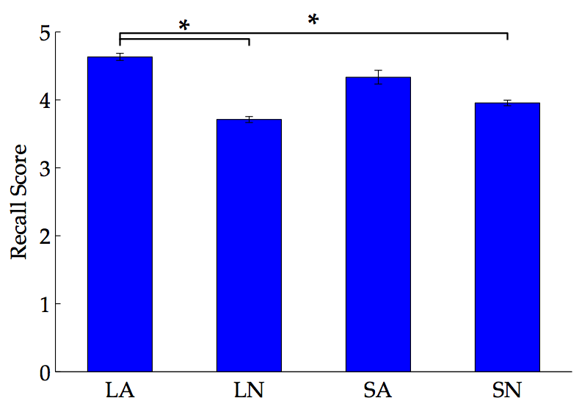
Results of Recall Test

Slide 22
Discuss
Short fixations relatively fail to memorize the emotionally arousing events than long fixations do.
There is no evidence that all long fixations associate with the formation of long-term memory. However, we can have a question that the emotionally arousing event may induce the active long fixations when it affects.
Though, other events can receive long fixations, in this cases, subjects hardly recall that events. It seems to be caused by looking passively or even blankly.

Slide 23
Conclusions
What the visual constraints induce the long term of the fixation duration?
Do the long fixations correlate with the formation of long-term memory?
Does the fixation duration indicate the effectiveness of the long-term memory formation for the emotionally arousing sequences?
Alerted, successive, stationary
No
Active long fixation does

Slide 24
Further Works

